Slide 1
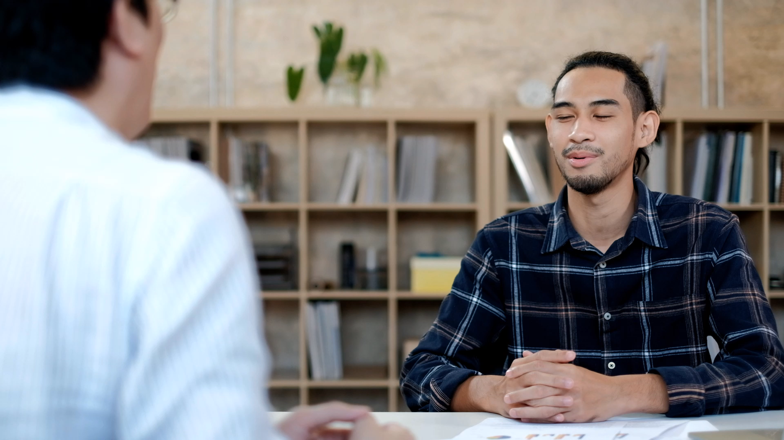

Body Language and Dress Code in Interviews
Body language conveys attitude, confidence, and engagement.
Maintain a confident posture for alertness and readiness.
Appropriate eye contact signals confidence and respect.
Balance nodding and gestures to avoid distraction.
A genuine smile shows approachability and enthusiasm.
Dress code reflects understanding of company culture.
Research company dress code for appropriate interview attire.
Neat, clean, and well-fitted clothing demonstrates professionalism.
Presenting professionally impacts perceived capability for the role.
Notes:
In the nuanced world of job interviews, especially for roles as dynamic as project management, body language and dress code serve as critical components of non-verbal communication. They silently articulate professionalism, confidence, and your fit within a company's culture, playing a pivotal role in reinforcing the verbal message you aim to convey.
Body language in interviews is a powerful tool that communicates much about your attitude, confidence, and engagement level. Positive body language begins with a confident posture—sitting up straight, not slouching, which conveys alertness and readiness. It’s about maintaining appropriate eye contact, which signals confidence and respect, while too little may suggest nervousness, and too much can come across as confrontational.
Gestures like nodding show that you're actively listening and engaging with the interviewer's questions or comments. However, it's crucial to balance this with not overdoing it, as excessive nodding or hand gestures can be distracting. Similarly, a genuine smile can make you appear approachable and enthusiastic about the position. In essence, your body language should aim to project a composed, confident, and positive demeanor that complements your verbal responses.
The dress code for an interview is equally telling, often considered a reflection of your understanding of the company's culture and your professionalism. The key is to align your attire with the company's dress code—whether that's formal, business casual, or casual. Doing a bit of research on the company culture, or even asking the HR representative about the appropriate dress code for the interview, can provide valuable guidance.
For a formal corporate environment, traditional business attire is expected. However, for companies with a more relaxed culture, smart casual might be more appropriate. Regardless of the specific dress code, your clothing should be neat, clean, and well-fitted, showing that you've put thought and effort into your appearance. This attention to detail can leave a positive impression, demonstrating respect for the interviewer and the opportunity.
In project management interviews, where the role often involves leading teams and interacting with various stakeholders, the ability to present yourself professionally through both body language and attire can significantly impact your perceived capability to fill the role effectively. It's not just about what you wear, but how you wear it, and not just about the content of your speech, but how you physically present your narrative.

